Slide 1


Banking Simulation
A comprehensive simulation of modern banking operations developed entirely in low-level x86 Assembly. This project explores memory management, register manipulation, and interrupt-driven I/O within a legacy computing environment.
Presented By
Presented To
Ashab Uddin-232002274
RukonuzZaman Topu
-232002280
Dept of CSE
Green University of Bangladesh
Ms. Jarin Tasnim Tonvi
Lecturer
Dept of CSE
Green University of Bangladesh

Slide 2

PROJECT FOUNDATION
System Overview & Tools
This project implements a fully functional banking interface from the ground up. By bypassing high-level abstractions, we gain direct control over the hardware to manage financial data securely.
Language: 8086 Intel Assembly (16-bit real mode)
Emulator: DOSBox for 8086 hardware virtualization
Scope: 200+ lines of optimized functional code

Slide 3

CORE CAPABILITIES
Account Management
The system handles the lifecycle of a bank account, ensuring data integrity from the moment of creation.
Auto-Generation
PIN Security
Initial Deposit
Accounts are indexed automatically starting from ID 100 to ensure unique identification.
Mandatory 4-digit PIN setup during registration for all subsequent transaction access.
A minimum requirement of ₹500 is enforced to maintain active account status.

Slide 4
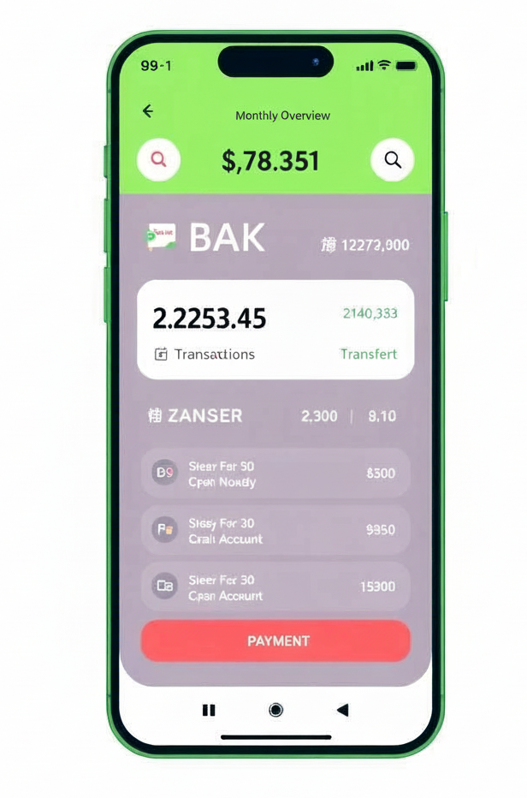


OPERATIONAL LOGIC
Transaction Processing
The engine processes three primary financial activities using register-based arithmetic and status flag validation.
Deposits
Add funds to balance after identity verification.
Withdrawals
Deduct funds with real-time balance checks.
Transfers
Move funds securely to destination account 1001.

Slide 5
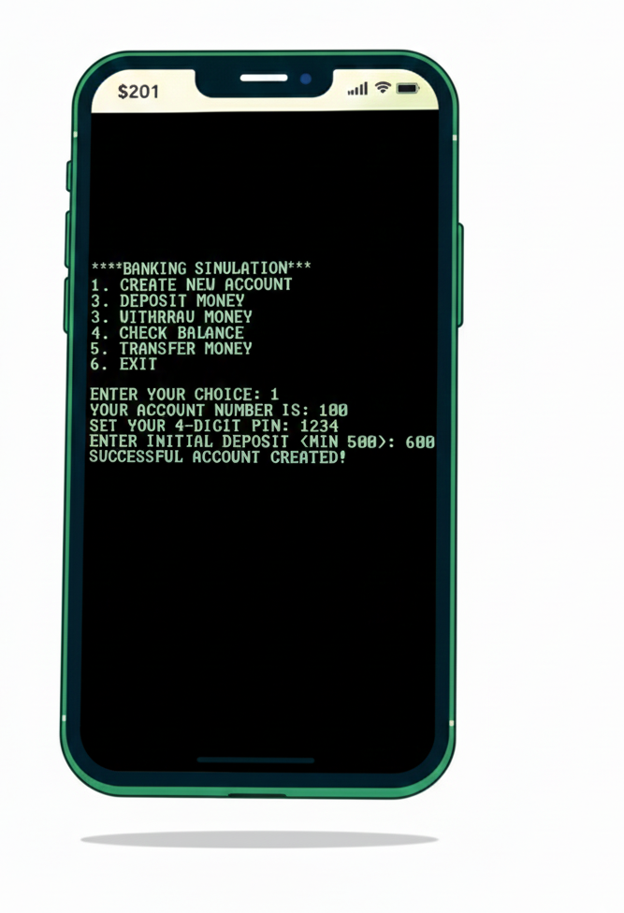
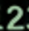
Output – Create New Account
Key Features
Auto-generated account number
User-defined 4-digit PIN
Minimum initial deposit validation (≥ $500)

Slide 6
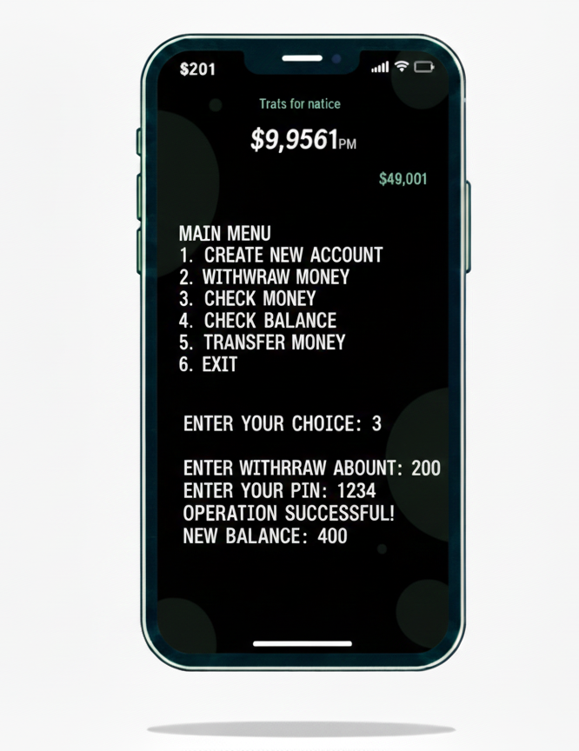


Output – Withdraw Operation
Key Features
Prevents withdrawal beyond balance
PIN-based security
Displays updated balance

Slide 7


SECURITY ARCHITECTURE
Validation & Error Handling
Execute or Error
Perform action or show error
Balance Check
Ensure sufficient funds
PIN Auth Check
Verify PIN validity
User Input
Enter credentials and amount
Robustness: The system uses conditional jumps (JNE, JB) to prevent invalid operations such as overdrafts or non-numeric input entries.

Slide 8

Thank You

